Slide 1
Introduction to C Programming
By
Dr. Mohammad Arif,
SCOPE, VIT, Vellore

Slide 2
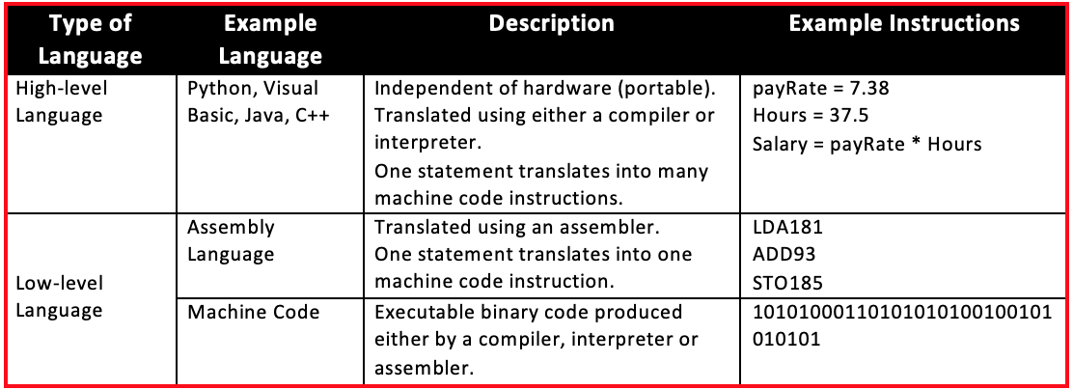
Classification of languages
High-level Languages – Python, Visual Basic, Java, C, C++, SQL and many more.
Low-level Languages – Hardware/Processor-specific assembly languages and machine code.

Slide 3
History of C
ALGOL 1960 International Group
BCPL 1967 Martin Richards
B 1970 Ken Thompson
C 1972 Dennis Ritchie
1

Slide 4
History of C --- contd..
K&R C 1978 Kernighan & Ritchie
ANSI C 1989 ANSI committee
(American National Standards Institute)
ANSI/ISO C 1990 ISO committee
(International Standards Organization)
1

Slide 5
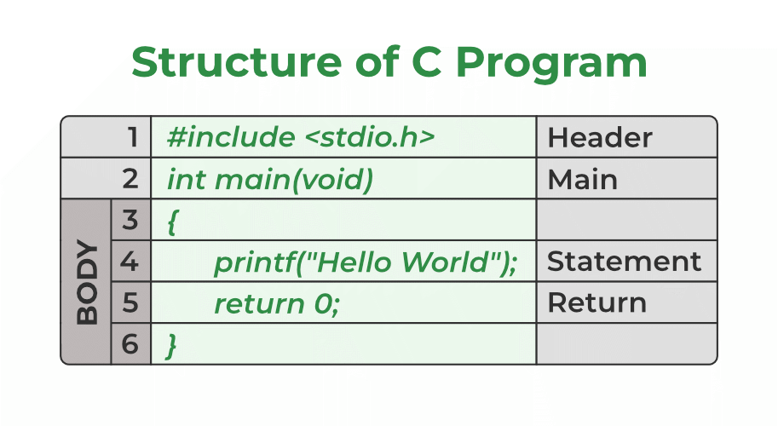

Slide 6
1. Header Files Inclusion – Line 1 [#include <stdio.h>]
The first and foremost component is the inclusion of the Header files in a C program.
A header file is a file with extension .h which contains C function declarations and macro definitions to be shared between several source files.
All lines that start with # are processed by a preprocessor which is a program invoked by the compiler. The preprocessor copies the preprocessed code of stdio.h to our file.
The .h files are called header files in C.
Some of the C Header files:
math.h – Defines common mathematical functions
string.h – Defines string handling functions
stddef.h – Defines several useful types and macros.
stdio.h – Defines core input and output functions
stdlib.h – Defines numeric conversion functions, pseudo-random network generator, and memory allocation…… etc. etc.

Slide 7
Preprocessor
1) When we use include directive, the contents of included header file (after preprocessing) are copied to the current file.
Angular brackets < and > instruct the preprocessor to look in the standard folder where all header files are held.
Double quotes “ ” instruct the preprocessor to look into the current folder (current directory).
2) When we use define for a constant, the preprocessor produces a C program where the defined constant is searched and matching tokens are replaced with the given expression. For example in the following program max is defined as 100.
#include <stdio.h>
#define max 100
int main()
{
printf("max is %d", max);
return 0;
}
Output:
max is 100

Slide 8
2. Main Method Declaration – Line 2 [int main()]
The next part of a C program is to declare the main() function. It is the entry point of a C program and the execution typically begins with the first line of the main(). The empty brackets indicate that the main doesn’t take any parameter The int that was written before the main indicates the return type of main(). The value returned by the main indicates the status of program termination.
In new version int main() is same as int main(void).
What is the difference? In C++, there is no difference, both are same. Both definitions work in C also, but the second definition with void is considered technically better as it clearly specifies that main can only be called without any parameter.
In C, if a function signature doesn’t specify any argument, it means that the function can be called with any number of parameters or without any parameters.
“int main(void)” is a recommended practice in C

Slide 9
3. Body of Main Method – Line 3 to Line 6 [enclosed in {}]
The body of a function in the C program refers to statements that are a part of that function.
It can be anything like manipulations, searching, sorting, printing, etc.
A pair of curly brackets define the body of a function.
All functions must start and end with curly brackets.

Slide 10
4. Statement – Line 4 [printf(“Hello World”);]
Statements are the instructions given to the compiler.
In C, a statement is always terminated by a semicolon (;).
In this particular case, we use printf() function to instruct the compiler to display “Hello World” text on the screen.

Slide 11
5. Return Statement – Line 5 [return 0;]
The last part of any C function is the return statement. The return statement refers to the return values from a function.
This return statement and return value depend upon the return type of the function.
The return statement in our program returns the value from main(). The returned value may be used by an operating system to know the termination status of your program.
The value 0 typically means successful termination.
If no return statement appears in a function definition, control automatically returns to the calling function after the last statement of the called function is executed.
The return value of main() function shows how the program exited. The normal exit of program is represented by zero return value. If the code has errors, fault etc., it will be terminated by non-zero value.
In C++ language, the main() function can be left without return value. By default, it will return zero.

Slide 12
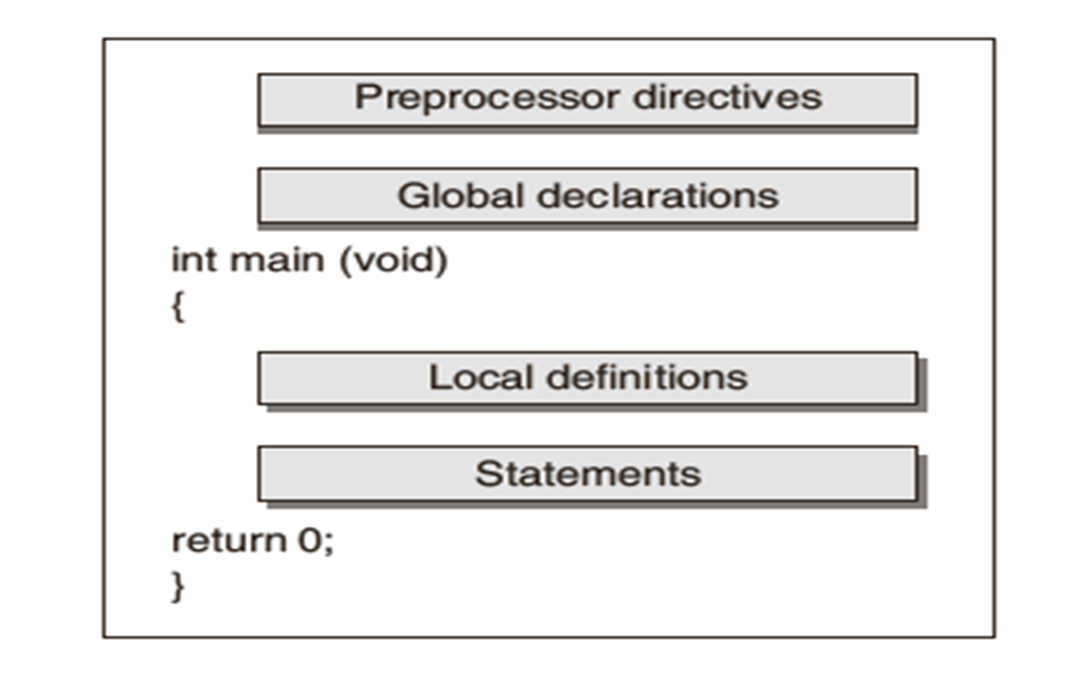
STRUCTURE : C PROGRAM

Slide 13
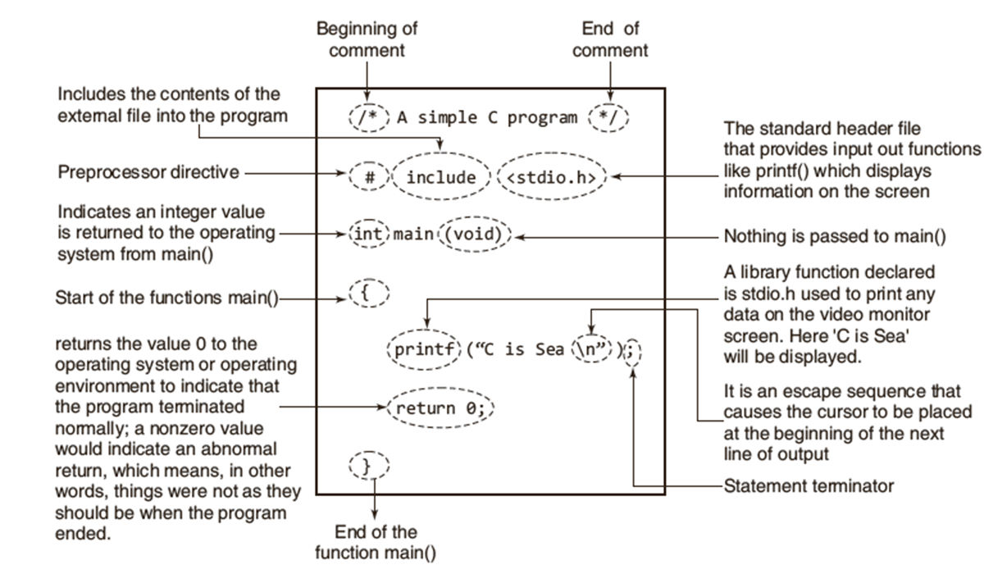
ILLUSTRATED VERSION OF A PROGRAM

Slide 14
Compilation process
Compiler converts a C program into an executable. There are four phases for a C program to become an executable:
Pre-processing
Compilation
Assembly
Linking

Slide 15
Preprocessing
This is the first phase through which source code is passed. This phase includes:
Removal of Comments
Expansion of Macros
Expansion of the included files.
The preprocessed output is stored in the filename.i.

Slide 16
Compiling
The next step is to compile the file and produce an intermediate compiled output file. This file is in assembly-level instructions.
The compiled output file is filename.s

Slide 17
Assembly
In this phase the filename.s is taken as input and turned into filename.o by assembler.
This file contain machine level instructions.
At this phase, only existing code is converted into machine language, the function calls like printf() are not resolved.

Slide 18
Linking
This is the final phase in which all the linking of function calls with their definitions are done.
Linker does some extra work also, it adds some extra code to our program which is required when the program starts and ends.
Note that GCC by default does dynamic linking, so printf() is dynamically linked in the above program.
GCC stands for GNU Compiler Collection
GNU stands for Gnu’s Not Unix, and it is pronounced as “g-noo”. GNU is a free and open-source operating system that was started in 1984 by Richard Stallman. GNU is based on the Unix operating system, but it has been greatly modified over the years

Slide 19
VARIABLES
A variable is a container(storage area) to hold data.
All variables have three important attributes:
data type
name
value
Eg: int a = 10;
float b = 2.5;
char c = ‘f’;

Slide 20
Rules for defining variables
A variable can have alphabets, digits, and underscore.
A variable name can start with the alphabet, and underscore only. It can't start with a digit.
No whitespace is allowed within the variable name.
A variable name must not be any reserved word or keyword, e.g. int, float, etc.

Slide 21
Data Types
Each variable in C has an associated data type.
Types | Description
Primitive Data Types | Arithmetic types can be further classified into integer and floating data types.
Void Types | The data type has no value or operator and it does not provide a result to its caller. But void comes under Primitive data types.
User Defined DataTypes | It is mainly used to assign names to integral constants, which make a program easy to read and maintain
Derived types | The data types that are derived from the primitive or built-in datatypes are referred to as Derived Data Types.

Slide 22
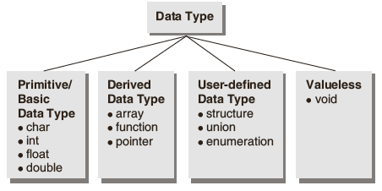
CLASSIFICATION :DATA TYPE

Slide 23
BASIC DATA TYPES:SIZE
Data Type | Memory (bytes) | Range | Format Specifier
int | 4 | -2,147,483,648 to 2,147,483,647 | %d
unsigned int | 4 | 0 to 4,294,967,295 | %u
long int | 4 | -2,147,483,648 to 2,147,483,647 | %ld
unsigned long int | 4 | 0 to 4,294,967,295 | %lu
long long int | 8 | -(2^63) to (2^63)-1 | %lld
unsigned long long int | 8 | 0 to 18,446,744,073,709,551,615 | %llu
signed char | 1 | -128 to 127 | %c
unsigned char | 1 | 0 to 255 | %c
float | 4 | 1.2E-38 to 3.4E+38 | %f
double | 8 | 1.7E-308 to 1.7E+308 | %lf
long double | 16 | 3.4E-4932 to 1.1E+4932 | %Lf

Slide 24
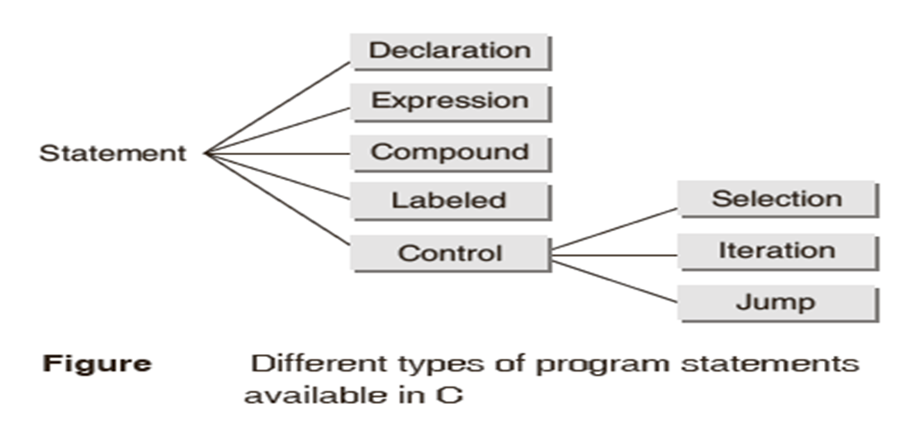
PROGRAM STATEMENTS
A statement is a syntactic construction that performs an action when a program is executed.
All C program statements are terminated with a semi-colon (;).

Slide 25
Input/Output sample program
#include <stdio.h>
int main()
{
int x;
printf("enter the value of x: ");
scanf("%d", &x);
printf("the value of x = %d", x);
return (0);
}
Output:
enter the value of x: 6
the value of x = 6

Slide 26
KEY WORDS
Keywords are system defined identifiers.
Keywords are reserved words.
They have specific meaning in the language and cannot be used by the programmer as a variable or constant name.
C is case sensitive.
32 Keywords.

Slide 27
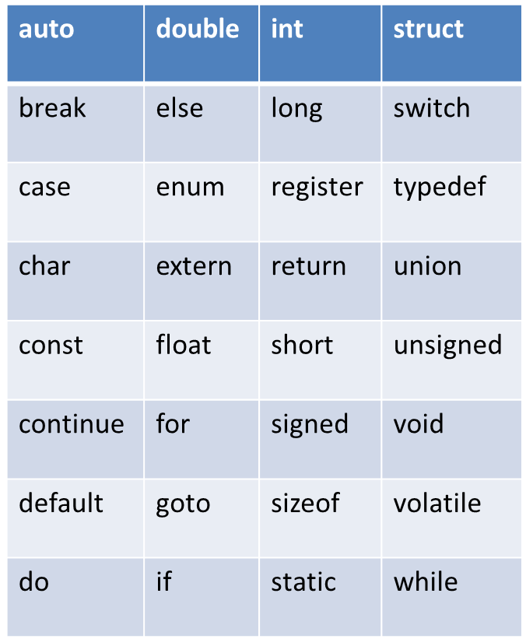
KEY WORDS

Slide 28
CONSTANT
A constant is a value or an identifier whose value cannot be altered in a program. For example: 1, 2.5
The const keyword specifies that a variable's value is constant and tells the compiler to prevent the programmer from modifying it.
An identifier also can be defined as a constant.
e.g. const double PI = 3.14 / double const PI = 3.14
Here, value of PI is a constant.

Slide 29
TYPES OF CONSTANTS
Integer constant eg: 1
Floating-point constant eg: 2.5
Character constant eg: ’a’
String constant eg: ”good”

Slide 30
Operators and Expressions
Operator: An operator is a symbol or letter used to indicate a specific operation on variables in a program.
Example: the symbol `+' is an add operator that adds two data items called operands.
Expression: An expression is a combination of operands (i.e., constants, variables, numbers) connected by operators and parentheses.
Example: In the expression given below, A and B are operands and `+' is an operator.
A + B

Slide 31
Operators and Expressions contd…
An expression that involves arithmetic operators is known as an arithmetic expression. The computed result of an arithmetic expression is always a numerical value.
An expression that involves relational and/or logical operators is called a Boolean expression or logical expression. The computed result of such an expression is a logical value, i.e., either 1 (True) or 0 (False).

Slide 32
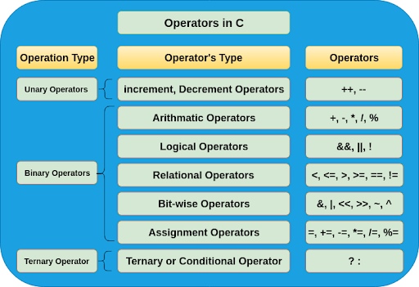
Types of Operators

Slide 33
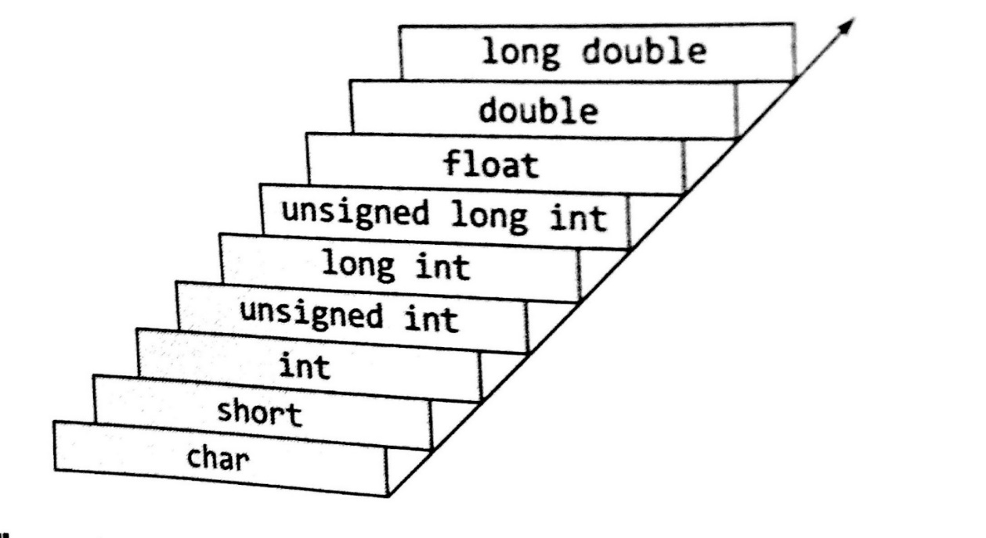
Type Conversion: Promotion Hierarchy
Operands of the lower type can be implicitly converted to the higher type (in C)
If one operand of an expression is of a smaller type than the other operand, the smaller operand is promoted to the type of the larger operand.
For example, if you add a char and an int, the char will be promoted to int before the addition is performed.

Slide 34
Type casting: Implicit
Implicit type conversion in C happens automatically when a value is copied to its compatible data type.
If the operands are of two different data types, then an operand having lower data type is automatically converted into a higher data type.
#include<stdio.h>
int main()
{
short a=10; //initializing variable of short data type
int b; //declaring int variable
b=a; //implicit type casting
printf("%d\n",a);
printf("%d\n",b);
}
Output:
10
10

Slide 35
Variable implicit type conversion in expressions
When executing expressions of mixed types, C automatically converts integer to floating point and back again as needed.
int x = 1; x is declared an integer
x = x + 4.3 integer + floating point ??
x is converted to floating point
floating point addition
result is converted (truncated) back to integer for assignment (result is x = 5)

Slide 36
Type casting: Implicit
#include <stdio.h>
main() {
int number = 1;
char character = 'k'; /*ASCII value is 107 */
int sum;
sum = number + character;
printf("Value of sum : %d\n", sum );
}
Output:
Value of sum : 108
Note: Here, compiler has done an integer promotion by converting the value of ‘k’ to ASCII before performing the actual addition operation.

Slide 37
Type casting: Explicit
In implicit type conversion, the data type is converted automatically.
int result, var1=10, var2=3;
result=var1/var2;
In this case, after the division performed on variables var1 and var2 the result stored in the variable “result” will be in an integer format.
The value stored in the variable “result” loses its meaning because it does not consider the fraction part which is normally obtained in the division of two numbers.
To force the type conversion in such situations, we use explicit type casting.
(type-name) expression

Slide 38
Type casting: Explicit
#include<stdio.h>
int main()
{
float a = 1.2;
//int b = a; //Compiler will throw an error for this
int b = (int)a + 1;
printf("Value of a is %f\n", a);
printf("Value of b is %d\n",b);
return 0;
}
Output:
Value of a is 1.200000 (As C displays both float and double variables to six decimal places)
Value of b is 2

Slide 39
Relational Operator
Used to compare two values and the result of such operation is always logical, i.e., either true or false.
Relational operators evaluate to 1, representing the true outcome, or 0, representing the false outcome
Operator | Meaning | Example | Return Value
> | Greater than | 5>4 | 1
< | Lesser than | 5<4 | 0
>= | Greater than or equal to | 5>=4 | 1
<= | Lesser than or equal to | 5<=4 | 0
!= | Not equal to | 5!=4 | 1
= = | Equal to | 5= =4 | 0

Slide 40
Logical Operators
C provides three logical operators for forming logical expressions.
Like the relational operators, logical operators evaluate to 1 or 0.
Operator | Meaning | Example | Return Value
&& | Logical AND | 5>4 && 6<9 | 1
|| | Logical OR | 5<4 || 6<9 | 1
! | Logical NOT | ! (5>=5) | 0

Slide 41
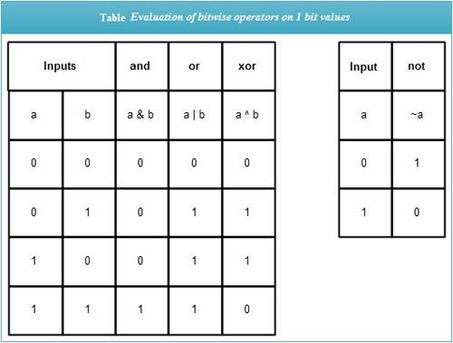
Bitwise – and , or, xor, not

Slide 42
Bitwise Operators
Bitwise operators are used for the manipulation of integer data items at bit level.
Operator | Meaning | Example | Answer | Explanation
& | Bitwise AND | 8&4 | 0 | 1000 & 0100 = 0000
| | Bitwise OR | 8|4 | 12 | 1000 | 0100 = 1100
^ | Bitwise XOR | 8^2 | 10 | 1000 ^ 0010 = 1010
~ | One’s complement | ~8 | 7 | 1000 = 0111
>> | Right Shift | 8>>2 | 2 | 1000 >>2 =0010
<< | Left Shift | 2<<3 | 16 | 0010<<3 = 10000

Slide 43
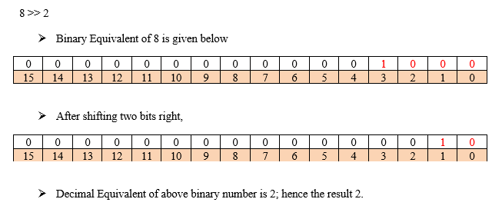
Right Shift - Example

Slide 44
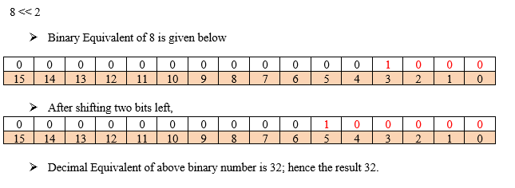
Left Shift - Example

Slide 45
Assignment Operators
Operator | Category | Example | Meaning
= | Simple Assignment | x=5 | x=5
+= | Compound Assignment | x+=5 | x=x+5
-= |  | x-=5 | x=x-5
*= |  | x*=5 | x=x*5
/= |  | x/=5 | x=x/5
%= |  | x%=5 | x=x%5
&= |  | x&=5 | x=x&5
^= |  | x^=5 | x=x^5
|= |  | x|=5 | x=x|5
>>= |  | x>>=2 | x=x>>2
<<= |  | x<<=2 | x=x<<2

Slide 46
Increment/decrement Operators
These operators require only one operand or data item.
Increment and decrement operators: The unary ‘++’ and ‘--’ operators increment or decrement the value in a variable by 1.
Operator | Meaning | Example
- | Minus | a=-10
++ | Increment | x=++y
-- | Decrement | x=--y

Slide 47
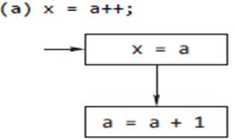
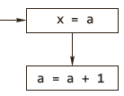
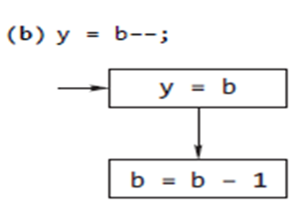
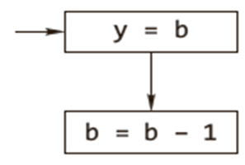
Post increment and decrement operators
First action : Store the value of a in the variable x
Second Action : Increment value of a by 1 and store the result in the variable a
First Action : Put value of b in the variable y
Second Action : Decrement value of b by 1 and put result in the variable b

Slide 48
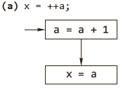
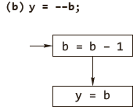
Pre increment and decrement operators
First action: increment value of a by 1 and store result in the variable a.
Second action: store value of a in the variable x.
First action: decrement value of b by 1 and store result in the variable b.
Second action: store value of b in the variable y.

Slide 49
Pre increment and Post increment operators
i=5;
j=i++;
In this case, the precedence of = is higher than postfix ++. So, value of i is assigned to j before incrementing i. Here j becomes 5 and i becomes 6.
i=5;
j=++i;
In this case, the precedence of prefix ++ is more than = operator. So i will increment first and the incremented value is assigned to j Here i and j both become 6.

Slide 50
pre and post-increment - Example
#include<stdio.h>
void main()
{
int x,y;
x=10;
y=12;
x=y++;
++x;
printf("x=%d\t y=%d",x,y);
}
Output
x=13 y=13

Slide 51
Comma Operator
The comma operator is used to bring together a number of expressions which are performed in a sequence from left to right. For example, the following statement
a = (x = 5, x + 2);
executes in the following order:
(i) value 5 is assigned to variable x.
(ii) x is incremented by 2.
(iii) the value of expression x + 2 (i.e. 7) is assigned to the variable a.
The following points may be noted regarding comma operators.
A list of expressions, separated by comma, is always evaluated from left to right.
The comma operator has the lowest precedence among all C operators.

Slide 52
Size of Operator
sizeof - calculates the size of any data item or type.
It takes a single operand that may be a type name (e.g., int) or an expression (e.g.,100) and returns the size of the specified entity in bytes .
The outcome is totally machine-dependent.
If sizeof() holds an expression, it doesn’t get evaluated.
sizeof is the only operator which is also a keyword.

Slide 53
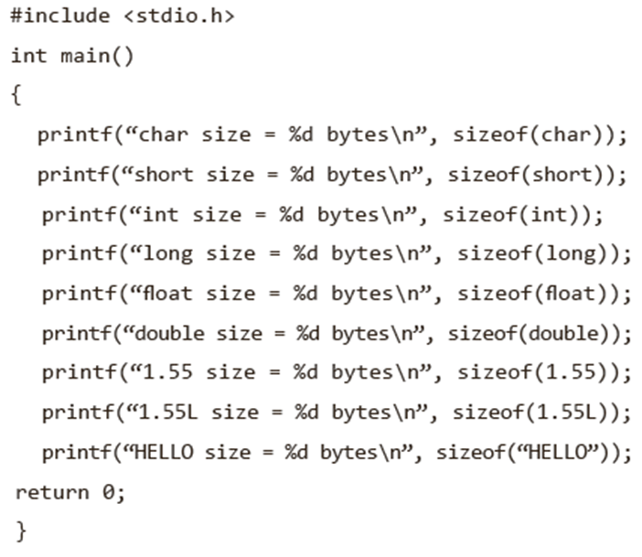
Size of Operator - Example

Slide 54
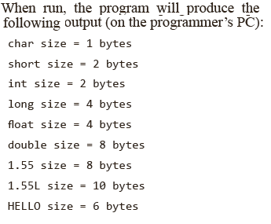

Slide 55
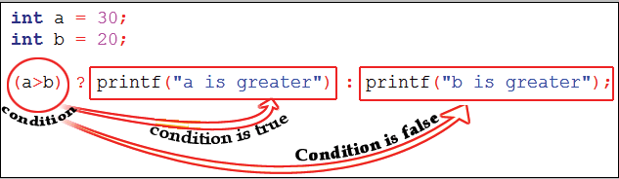
Ternary Operator
The operator using three operands or three variables is known as Ternary Operator
Conditional Operator (? :) is a Ternary Operator
Syntax :
expression-1 ? expression-2 : expression-3
In the above syntax, expression-1 is condition and expression-2 and expression-3 will be either value or variable or statement or any mathematical expression
Example:
int a=30, b = 20;
a>b ? printf (“a is greater") : printf (“b is greater");
Answer:
a is greater

Slide 56
Ternary Operator - Example
#include<stdio.h>
int main()
{
int n;
printf("Enter an integer:");
scanf("%d", &n);
(n% 2 == 0) ? printf("\n%d is a Even number\n",n) : printf("\n%d is a Odd number\n",n);
}
Case 1
n=5
n% 2 != 0 hence expression 3 will get executed
Output: 5 is a Odd number
Case 2
n=6
n% 2 == 0 hence expression 2 will get executed
Output: 6 is a Even number

Slide 57
Ternary operator - Nested
#include<stdio.h>
int main()
{
int k, num=30;
k = (num>5 ? (num <=10 ? 100 : 200): 500);
printf("%d\n", k);
return 0;
}
Output:
200

Slide 58
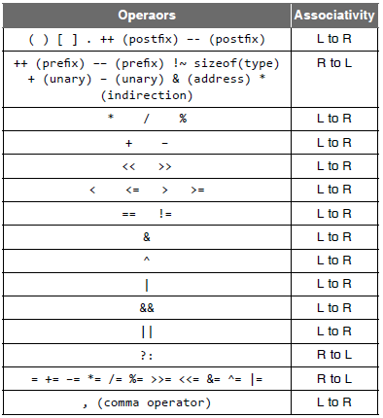
Expression Evaluation: Precedence and Associativity
1. We only use associativity when we have two or more operators that have the same precedence in an expression.
The point to note here is that associativity is not applicable when we are defining the order of evaluation of operands with different levels of precedence.
2. All the operators that have a similar level of precedence have the same associativity.

Slide 59
Example: operator precedence
#include<stdio.h>
int main() {
int num1 = 10, num2 = 20;
int result;
result = num1 * 2 + num2;
printf("\nResult is : %d", result);
return (0);
}
Explanation :
Step 1 : result = num1 * 2 + num2;
Step 2 : result = 10 * 2 + 20;
Step 3 : result = 20 + 20;
Step 4 : result = 40;

Slide 60
Example: operator associativity
#include<stdio.h>
int main() {
int num1 = 10, num2 = 20;
int result;
result = num1 * 2 + num2 * 2 ;
printf("\nResult is : %d", result);
return (0);
}
Explanation :
result = num1 * 2 + num2 * 2 ;
result = 10 * 2 + 20 * 2 ;
result = 20 + 20 * 2 ;
result = 20 + 40 ;
result = 60 ;

Slide 61
Data Input and Output
The I/O library functions are listed in the “header” file <stdio.h>.
Types:
Unformatted Input/Output Functions: Unformatted I/O functions are used only for character data type or character array/string and cannot be used for any other datatype.
These functions are used to read single input from the user at the console and it allows to display of the value at the console.
Formatted Input/Output Functions: Formatted I/O functions are used to take various inputs from the user and display multiple outputs to the user.
These types of I/O functions can help to display the output to the user in different formats using the format specifiers. These I/O supports all data types like int, float, char, and many more.

Slide 62
Unformatted Input/output functions
Input functions
getchar()
getch()
getche()
gets()
Output functions
putchar()
putch()
puts()

Slide 63
getchar()
Reads a single character from the input data stream; but does not return the character to the program until the ‘\n’ ( or ) enter key is pressed.
Syntax:-
variable = getchar();
Example:-
char c;
c = getchar();
Program
#include<stdio.h>
int main()
{
char c;
printf(“Enter a character”);
c=getchar();
printf(“c = %c ”,c);
return 0;
}
Output
Enter a character k
c = k

Slide 64
getch() and getche()
These functions read any alphanumeric character from the standard input device
The character entered is not displayed by the getche() until enter is pressed
The getche() accepts and displays the character.
The getch() accepts but does not display the character.
Syntax:
getche();
getch();

Slide 65
getch() and getche() - Program
// Example for getch() in C
#include <stdio.h>
#include <conio.h>
int main()
{
printf("%c", getch());
return 0;
}
// Example for getche() in C
#include <stdio.h>
#include <conio.h>
int main()
{
printf("%c", getche());
return 0;
}

Slide 66
putchar()
#include<stdio.h>
int main()
{
char ch;
printf("Enter a character: ");
scanf("%c", &ch);
putchar(ch);
return 0;
}
Output
Enter a character: r
r
This function prints one character on the screen at a time which is read by standard input.
Syntax:
putchar( variable name);
Example:
char c= ‘c’;
putchar(c);

Slide 67
putch()
Program
#include<stdio.h>
#include<conio.h> //This function is declared in conio.h
int main()
{
char ch;
printf("Press any key\n");
ch = getch();
printf(" You pressed : ");
putch(ch);
return 0;
}
Output:
Press any key
You pressed : a
This function prints any alphanumeric character taken by the standard input device
Syntax:
putch( variable name);
Example:
char c= ‘c’;
putch(c);

Slide 68
gets()
String I/O
This function is used for accepting any string (stream of characters) until the enter key is pressed
Syntax
char str[length of string in number];
gets(str);
Example:
char name[15];
gets(name);
Program
#include<stdio.h>
int main()
{
char ch[30];
printf("Enter the string: ");
gets(ch);
printf("Entered string: %s ", ch);
return 0;
}
Output:
Enter the string: VIT, Vellore
Entered string: VIT, Vellore

Slide 69
puts()
Program
#include<stdio.h>
int main()
{
char ch[30];
printf(“Enter the string:”);
gets(ch);
puts(“Entered string was : ”);
puts(ch);
return 0;
}
Output:
Enter the string: riviera is on
Entered string: riviera is on
This function prints the string or character array.
It is opposite to gets()
Syntax
char str[length of string in number];
gets(str);
puts(str);

Slide 70
Formatted Input and Output Functions
printf() - output function
scanf() - input function

Slide 71
printf()
Output function
General form:
printf(“control_string and format specifier”,variable1,variable2, variable3,...);
Example: printf(“The numbers are %d and %d”,number1,number2);

Slide 72
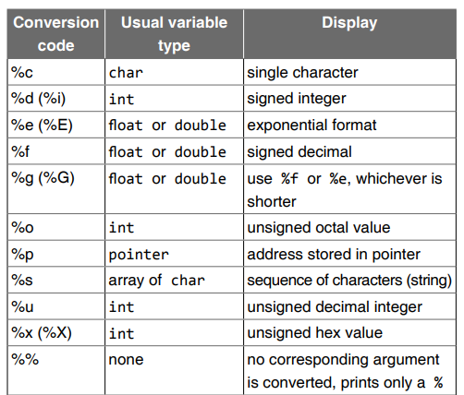
Format Specifiers

Slide 73
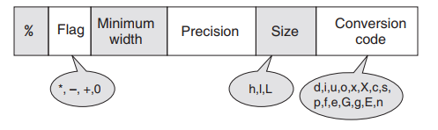
Parts of conversion specifier field for printf()
The percent sign and conversion code are required
Other modifiers such as width and precision are optional.
width specifies the total number of characters used to display the value
precision indicates the number of characters used after the decimal point. The precision option is only used with floats or strings.
Default precision value is 6

Slide 74
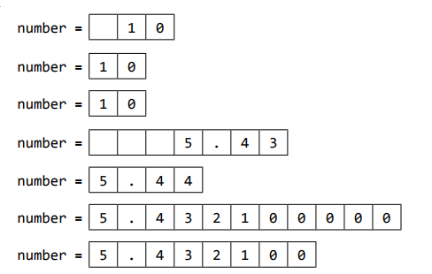
Examples
printf("number=%3d\n", 10);
printf("number=%2d\n", 10);
printf("number=%1d\n", 10);
printf("number=%7.2f\n", 5.4321);
printf("number=%.2f\n", 5.4391);
printf("number=%.9f\n", 5.4321);
printf("number=%f\n", 5.4321);
After decimal digits will be rounded off

Slide 75
Flag characters used in printf()
Flag | Meaning
- | Left justify the display
+ | Display positive or negative sign of value
Space | Display space if there is no sign
0 | Pad with leading zeros

Slide 76

Example
printf(“number=%06.1f\n”, 5.5);
printf(“%-+6.1f=number\n”, 5.5);

Slide 77
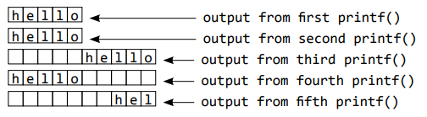
Example with strings
#include<stdio.h>
int main()
{
printf(“%s”,“hello”);
printf(“\n%3s”,“hello”);
printf(“\n%10s”,“hello”);
printf(“\n%-10s”,“hello”);
printf(“\n%10.3s”,“hello”);
return 0;
}

Slide 78
scanf()
General form:
scanf(“control_string”,variable1_address, variable2_address,...);
scanf() returns the number of input fields successfully scanned, converted, and stored
Example:
scanf(“%d”,”%d”,&num1,&num2);
Why &?
While scanning the input, scanf needs to store that input data somewhere. To store this input data, scanf needs to know the memory location of a variable.
& is also called as address of the variable.
For example, &var is the address of var.

